Slide 1
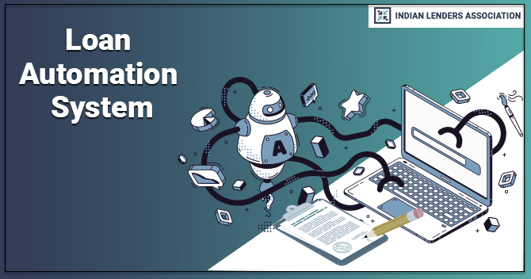
Advantages of using Automated Approval System for Loan Approval

Slide 2

About The Business Understanding
What is Automated Loan Approval System
How all queries helped to take decision
Final query for loan approval
Difference between Manual and Automation Loan approval
Advantages of Automated Approval System

Slide 3


Business Understanding
SBA loans are business loans partially guaranteed by the U.S. Small Business Administration and issued by participating lenders, usually banks. These loans have tight lending standards, but if you can qualify for an SBA loan, their flexible terms and low interest rates can make them one of the best small business loan.
And Accionlabs is an US company who provides SBA loans to all small startups and now they decided to make a automated system which will check all parameter and give us the output as should we decline or approve the loan.

Slide 4
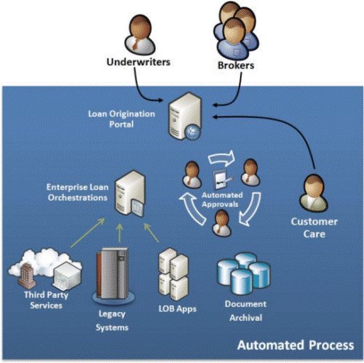
What is Automated Loan Approval System ?
Automated loan processing systems digitize and automate the entire loan cycle by using the latest cloud and web technologies. A quick loan processing mechanism is offered by the automated loan processing system, rather than the legacy system, which required paperwork and face-to-face interaction. It assists in simplifying the loan process by rapidly identifying applicants who meet the lending criteria, processing loans efficiently, and approving them promptly. In addition, it improves the overall accuracy of decision-making. As well as offering better security and 24x7 online support, an automated loan management system brings a new concept to loan management.

Slide 5
Queries For Checking Parameters To Approve A Loan

Slide 6
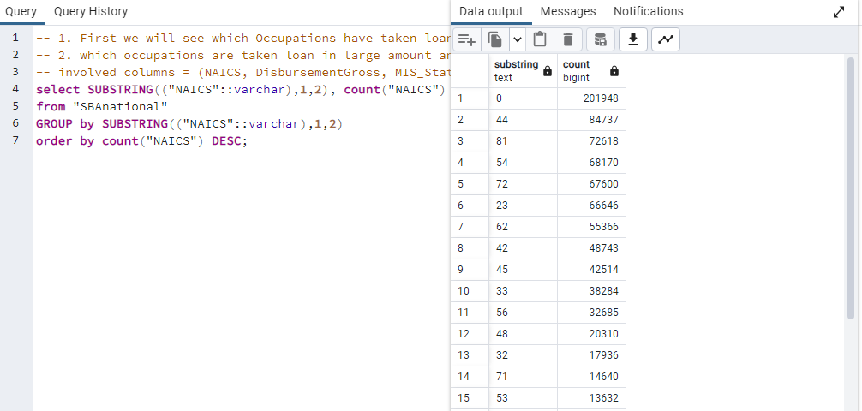
Count for Applicants from Each Occupation
Checked here is to see the count for each occupation. Here Occupation is given with NAICS code. The NAICS code list is given here.
Almost 201948 applicants are mentioned there occupation code as 0 which clearly indicates the data anomaly here. So we will only consider non zero code.
Most of applicants are comes under code 44 which indicates Retail Trade as their Occupation. Or we can say Retail Trade is their SBA

Slide 7
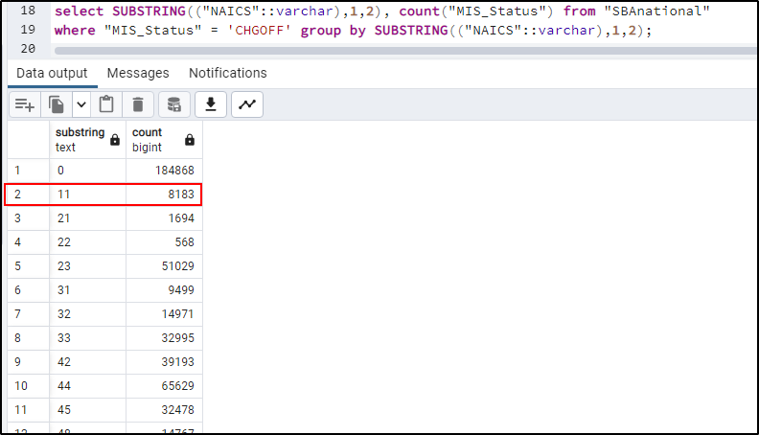
Comparison Among Occupation vs Disbursement Gross vs MIS Status
Most of the loans which are in higher amount taken by people who are having business related to Agriculture, Fishing, Hunting etc.
Even most of them paid back the loan fully on time. Count for PIF is 8183 for NAICS code 11 and defaulters are only 812.
Highest amount of loan taken by a defaulter is $2,000,000
The Highest amount for non-defaulter is $3,350,000

Slide 8
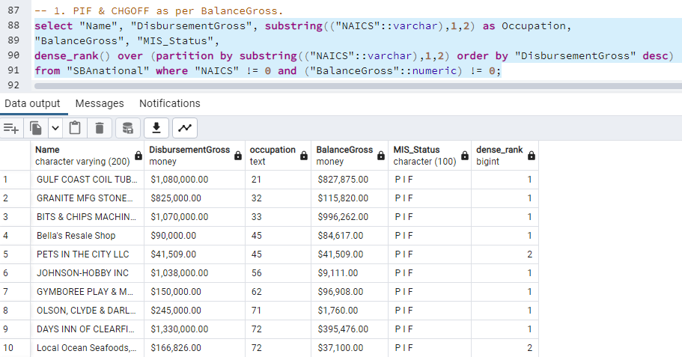
Comparison Among Occupation vs Disbursement Gross vs MIS Status vs Balance Gross
Parameter BalanceGross is having very interesting study.
Only 14 people are having Balance Gross and none of them are defaulters.
So, We can conclude here that if Someone is having Balance Gross we can approve their loan but will check other parameters carefully.

Slide 9
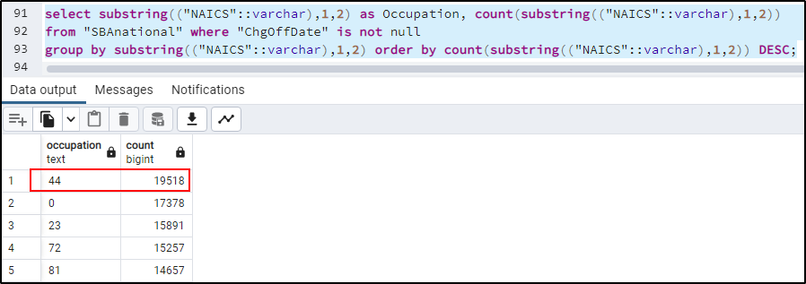
Comparison Among Occupation vs Disbursement Gross vs MIS Status vs Charged off date and Disbursement Date
People who are having charged off date they are considered as defaulters.
Most defaulters are belong from people who are having business with Retail Trade and count is 19518.
The lowest amount of defaulters are from occupation category Management of Companies and Enterprises.

Slide 10
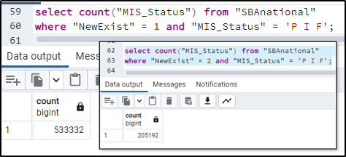
Comparison Among Occupation vs Disbursement Gross vs MIS Status vs New/Exist Business
The number of Exist businesses are larger in number who are non defaulters.
Highest loan amount taken by New business are $3,000,000 and they all are non-defaulters mostly.
Highest loan amount taken by existing businesses are $3,350,000 and mostly are non-defaulters.
And Occupation is Agriculture/Foresting etc.

Slide 11
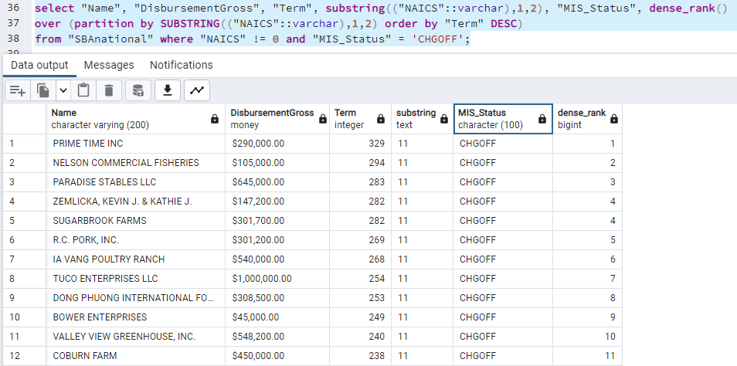
Comparison Among Occupation vs Disbursement Gross vs MIS Status vs Term
Terms are basically inversely correlated to Loan amount.
If Loan Amount if High and Term is Less then the person most likely to be a defaulters.
But some exceptions are present here.
But in this dataset we can see that loan amount with $2,90,000 having 329 term months are also a defaulter.
Term and Loan amount also having a relationship with other parameters as well

Slide 12
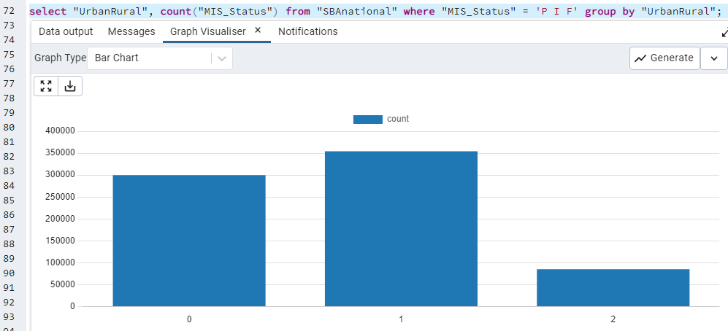
Comparison Among Occupation vs Disbursement Gross vs MIS Status vs Urban/Rural
Most Applicants are from Urban region as well as most non-defaulters and defaulters are also belong from Urban area.
Lowest Applicants are from Rural area and Most of them are non-defaulters.
Among 105,060 almost 85,347 are non-defaulters from Rural area which is almost 81%
For Urban area the percentage of non-defaulters are 75.5%
For Undefined it is about 92.8% are non-defaulters.

Slide 13
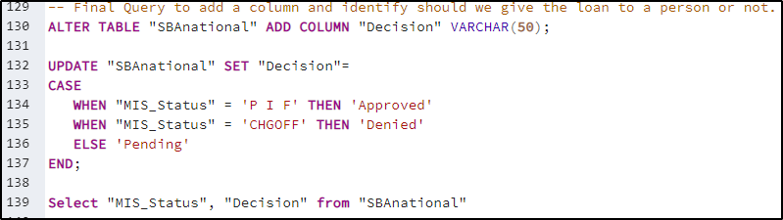
Final Query For Making Decision
Here we made our final query to making decision on basis of MIS_Status parameter.
Taken 3 conditions.
If Status is PIF or paid in full or non-defaulter then loan should be approved
If Status is CHGOFF or defaulters then loan should be denied.
If the status is undefined or null then loan approval decision will remain in pending state.
Before that we have done comparison will all other parameters to understand the relationship between some parameters
Final query is given here.

Slide 14
Advantages of Using Automated Loan Approval Criteria
Time Effective
Accuracy in Result
It takes lesser time than manual document checks
Time saves for sorting, cleaning and storing data manually.
Just one automated process can do all these steps for millions of data in 10 secs.
It gives more accurate result than manual data analysing.
Most of the automated process gives 80% to 90% accurate result in average.
So, more accuracy more business profit
Cost Effective
Report Presentation
Manual work needs more people to finish a single task in time which means more money.
But automated process is one time investment and cost effective.
Manual work takes more time to present a report in management team
But Automated process does this in few seconds with the data cleaning, mining and storing.

Slide 15
Thank you

